Slide 1
Forest Protection Vertebrates
Jakub Horák

Slide 2
Forest Protection
Biotics

Slide 3
Forest Protection
Biotic factors:
Insect
Game stocks etc.
Weeds
Fungi
…

Slide 4
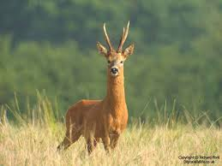
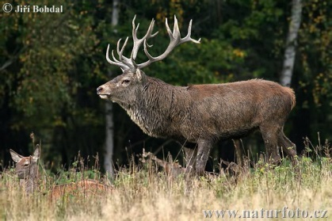
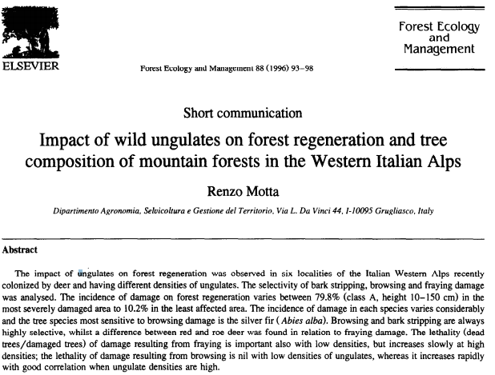
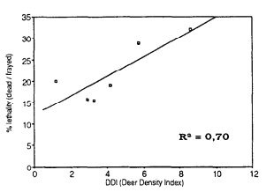
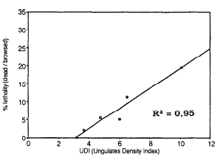
Forest Protection Wild ungulates
www.digitalwildlife.co.uk

Slide 5
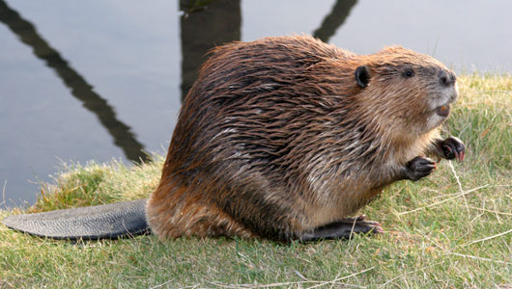
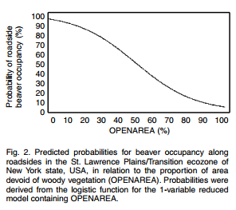
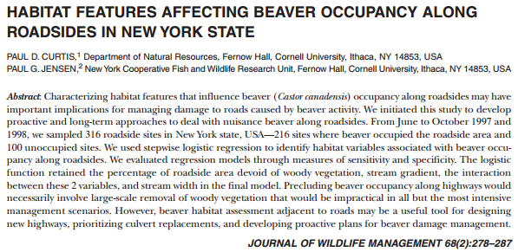
Forest Protection Beaver
www.onekind.org

Slide 6
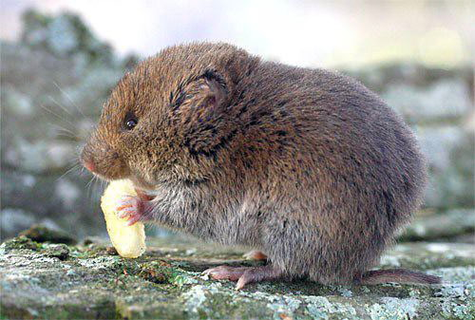
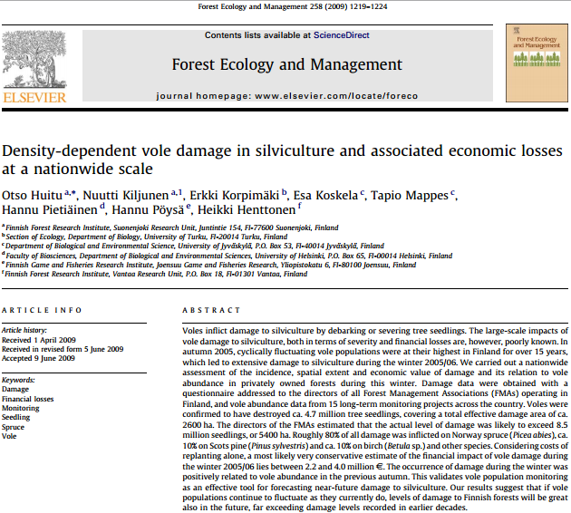
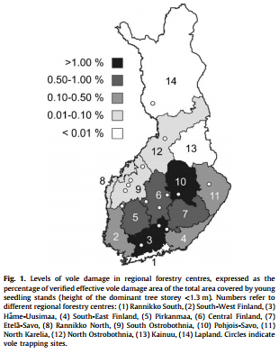
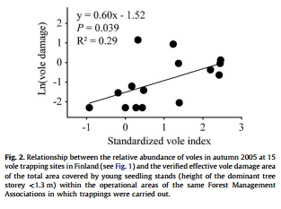
Forest Protection Rodents
www.hiltonpond.org

Slide 7
Forest Protection Conclusions
There are many types of damages caused by vertebrates.
Damages of small vertebrates are influenced by their population cycling
While large ones cause highly diversified types of damages – from losses on seeds to damages to stems of mature trees.
Protection against them is based on many types of approaches – from repellents to shooting.

Slide 8
Thank you for your attention

